Slide 1
Digital Logic & Design
Lecture 11

Slide 2
Recap
Karnaugh Maps
Mapping Standard SOP expressions
Mapping Non-Standard SOP expressions
Simplification of K-maps
Don’t care states

Slide 3
Mapping a Standard POS expression
Selecting n-variable K-map
0 marked in cell for each maxterm
Remaining cells marked with 1

Slide 4
Mapping of Standard POS expression
POS expression
AB\C | 0 | 1
00
01
11
10
A\BC | 00 | 01 | 11 | 10
0
1
Notes:
‹#›
Consider the Standard POS expression having a domain of 3 variables.
A 3-variable K-map is used as the POS expression has a domain of 3 variables.
The Standard POS expression has four maxterms 1, 2, 5 and 7
The cells representing the four maxterms are marked with 0s, remaining cells are marked with 1s.
Any of the two K-maps can be used

Slide 5
Mapping of Standard POS expression
POS expression
AB\C | 0 | 1
00 | 1 | 0
01 | 0 | 1
11 | 1 | 0
10 | 1 | 0
A\BC | 00 | 01 | 11 | 10
0 | 1 | 0 | 1 | 0
1 | 1 | 0 | 0 | 1
Notes:
‹#›
Consider the Standard POS expression having a domain of 3 variables.
A 3-variable K-map is used as the POS expression has a domain of 3 variables.
The Standard POS expression has four maxterms 1, 2, 5 and 7
The cells representing the four maxterms are marked with 0s, remaining cells are marked with 1s.
Any of the two K-maps can be used

Slide 6
Simplification of POS expressions using K-map
Mapping of expression
Forming of Groups of 0s
Each group represents sum term
3-variable K-map
1 cell group yields a 3 variable sum term
2 cell group yields a 2 variable sum term
4 cell group yields a 1 variable sum term
8 cell group yields a value of 0 for function

Slide 7
Simplification of POS expressions using K-map3
4-variable K-map
1 cell group yields a 4 variable sum term
2 cell group yields a 3 variable sum term
4 cell group yields a 2 variable sum term
8 cell group yields a 1 variable sum term
16 cell group yields a value of 0 for function
Notes:
‹#›

Slide 8
Simplification of POS expressions using K-map
AB\C | 0 | 1
00 | 0 | 1
01 | 1 | 0
11 | 1 | 1
10 | 0 | 1
A\BC | 00 | 01 | 11 | 10
0 | 0 | 1 | 1 | 1
1 | 1 | 0 | 0 | 0
Notes:
‹#›
Consider a three term POS expression mapped to a 3-variable column based K-map
A single group of two cells and a group of one cell are formed.
The first group of 0s comprising of cells 0 and 4 forms the sum term (B+C)
The second group comprising of cell 3 forms the sum term (A+B*+C*)
The simplified POS expression has to terms.
Consider the 4 term POS expression mapped to the 3-variable row based K-map.
Two groups of 2 cells each and a third group of single cell are formed.
The single cell group comprising of cell 0 forms the sum term (A+B+C)
The second group of 0s comprising of cells 5 and 7 forms the sum term (A*+C*)
The third group of 0s comprising of cells 6 and 7 forms the sum term (A*+B*)
The POS expression simplifies to a 3 term POS expression.

Slide 9
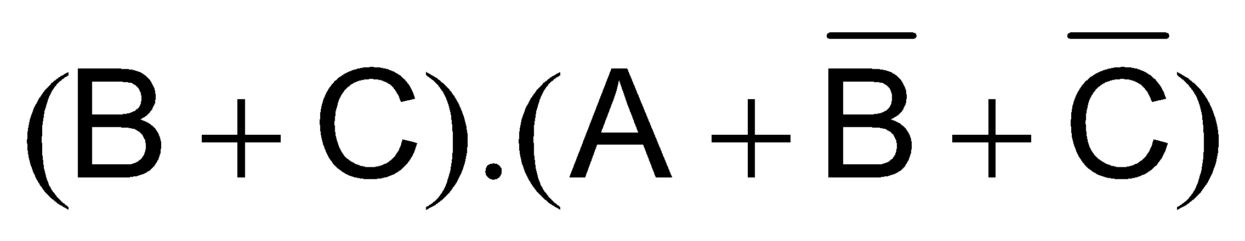
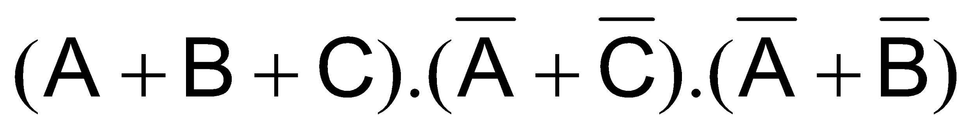
Simplification of POS expressions using K-map
AB\C | 0 | 1
00 | 0 | 1
01 | 1 | 0
11 | 1 | 1
10 | 0 | 1
A\BC | 00 | 01 | 11 | 10
0 | 0 | 1 | 1 | 1
1 | 1 | 0 | 0 | 0
Notes:
‹#›
Consider a three term POS expression mapped to a 3-variable column based K-map
A single group of two cells and a group of one cell are formed.
The first group of 0s comprising of cells 0 and 4 forms the sum term (B+C)
The second group comprising of cell 3 forms the sum term (A+B*+C*)
The simplified POS expression has to terms.
Consider the 4 term POS expression mapped to the 3-variable row based K-map.
Two groups of 2 cells each and a third group of single cell are formed.
The single cell group comprising of cell 0 forms the sum term (A+B+C)
The second group of 0s comprising of cells 5 and 7 forms the sum term (A*+C*)
The third group of 0s comprising of cells 6 and 7 forms the sum term (A*+B*)
The POS expression simplifies to a 3 term POS expression.

Slide 10
Simplification of POS expressions using K-map
AB\C | 0 | 1
00 | 0 | 0
01 | 1 | 1
11 | 1 | 1
10 | 0 | 1
A\BC | 00 | 01 | 11 | 10
0 | 0 | 0 | 1 | 1
1 | 1 | 1 | 1 | 0
Notes:
‹#›
Consider the 3 term POS expression mapped to the 3-variable column based K-map
Two groups of two cells are formed.
The first group of 0s comprising of cells 0 and 1 forms the sum term (A+B)
The second group of 0s comprising of cells 0 and 4 forms the sum term (B+C)
The POS expression simplifies to 2 terms.
Consider the 3 term POS expression mapped to the 3-variable row based K-map.
One group of 2 cells and another group of single cell are formed.
The first group of 0s comprising of cell 0 and 1 forms the sum term (A+B)
The second group comprising of cell 6 forms the sum term (A*+B*+C)
The POS expression has simplified to a two term POS expression.

Slide 11

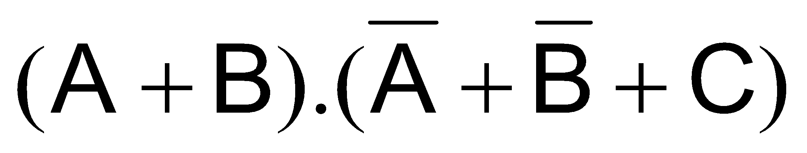
Simplification of POS expressions using K-map
AB\C | 0 | 1
00 | 0 | 0
01 | 1 | 1
11 | 1 | 1
10 | 0 | 1
A\BC | 00 | 01 | 11 | 10
0 | 0 | 0 | 1 | 1
1 | 1 | 1 | 1 | 0
Notes:
‹#›
Consider the 3 term POS expression mapped to the 3-variable column based K-map
Two groups of two cells are formed.
The first group of 0s comprising of cells 0 and 1 forms the sum term (A+B)
The second group of 0s comprising of cells 0 and 4 forms the sum term (B+C)
The POS expression simplifies to 2 terms.
Consider the 3 term POS expression mapped to the 3-variable row based K-map.
One group of 2 cells and another group of single cell are formed.
The first group of 0s comprising of cell 0 and 1 forms the sum term (A+B)
The second group comprising of cell 6 forms the sum term (A*+B*+C)
The POS expression has simplified to a two term POS expression.

Slide 12
Simplification of POS expressions using K-map
AB\CD | 00 | 01 | 11 | 10
00 | 0 | 1 | 1 | 0
01 | 0 | 0 | 1 | 1
11 | 1 | 1 | 1 | 1
10 | 1 | 1 | 1 | 0
Notes:
‹#›
Consider the 5 term POS expression mapped to the 4-variable K-map
Three groups of two cells are formed.
The first group of 0s comprising of cells 4 and 5 forms the sum term (A+B*+C)
The second group of 0s comprising of cells 0 and 4 forms the sum term (A+C+D)
The third group of 0s comprising of cells 2 and 10 forms the sum term (B+C*+D)
The POS expression has reduced to a 3 term POS expression

Slide 13
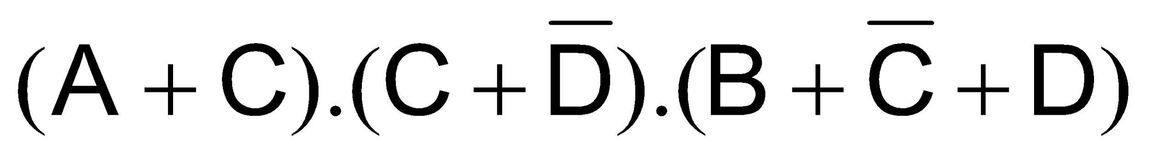
Simplification of POS expressions using K-map
AB\CD | 00 | 01 | 11 | 10
00 | 0 | 0 | 1 | 0
01 | 0 | 0 | 1 | 1
11 | 1 | 0 | 1 | 1
10 | 1 | 0 | 1 | 0
Notes:
‹#›
Consider the 8 term POS expression mapped to the 4-variable K-map
Two groups of 4 cells and one group of two cells are formed.
The first group of 0s comprising of cells 0, 1, 4 and 5 forms the sum term (A+C)
The second group of 0s comprising of cells 1, 5, 9 and 13 forms the sum term (C+D*)
The third group of 0s comprising of cells 2 and 10 forms the sum term (B+C*+D)
The POS expression has reduced to a 3 term POS expression.

Slide 14
Simplification of POS expressions using K-map
AB\CD | 00 | 01 | 11 | 10
00 | 1 | 0 | 1 | 1
01 | 0 | 0 | 0 | 1
11 | 1 | 1 | 1 | 0
10 | 1 | 0 | 1 | 1
Notes:
‹#›
Consider the 4-variable K-map
Three groups of 2 cells and one group of a single cell are formed.
The first group of 0s comprising of cells 4 and 5 forms the sum term (A+B*+C)
The second group of 0s comprising of cells 5 and 7 forms the sum term (A+B*+D*)
The third group of 0s comprising of cells 1 and 9 forms the sum term (B+C+D*)
The fourth group comprising of cell 14 forms the sum term (A*+B*+C*+D)

Slide 15
Simplification of POS expressions using K-map
AB\CD | 00 | 01 | 11 | 10
00 | 1 | 0 | 1 | 1
01 | 0 | 0 | 0 | 1
11 | 1 | 1 | 1 | 0
10 | 1 | 0 | 1 | 1
Notes:
‹#›
Consider the 4-variable K-map
Three groups of 2 cells and one group of a single cell are formed.
The first group of 0s comprising of cells 4 and 5 forms the sum term (A+B*+C)
The second group of 0s comprising of cells 5 and 7 forms the sum term (A+B*+D*)
The third group of 0s comprising of cells 1 and 9 forms the sum term (B+C+D*)
The fourth group comprising of cell 14 forms the sum term (A*+B*+C*+D)

Slide 16
Conversion between SOP & POS using K-map
Groups of 1s represents SOP expression
Groups of 0s represents POS expression

Slide 17
Conversion between SOP & POS using K-map
AB\CD | 00 | 01 | 11 | 10
00 | 1 | 0 | 1 | 1
01 | 0 | 0 | 0 | 1
11 | 1 | 1 | 1 | 0
10 | 1 | 0 | 1 | 1
Notes:
‹#›
Consider the 4-variable K-map used to simplify the POS expression.
If the same K-map is used but instead of grouping of 0s groups of 1s are formed an SOP expression is obtained.
Two groups of 4 cells and three groups of 2 cells are formed.
The first group of 1s comprising of cells 0, 2, 8 and 10 forms the product term B*D*
The second group of 1s comprising of cells 2, 3, 10 and 11 forms the product term B*C
The third group of 1s comprising of cells 12 and 13 forms the product term ABC*
The fourth group of 1s comprising of cells 13 and 15 forms the product term ABD
The fifth group of 1s comprising of cells 2 and 6 forms the product term A*CD*

Slide 18

Conversion between SOP & POS using K-map
AB\CD | 00 | 01 | 11 | 10
00 | 1 | 0 | 1 | 1
01 | 0 | 0 | 0 | 1
11 | 1 | 1 | 1 | 0
10 | 1 | 0 | 1 | 1
Notes:
‹#›
Consider the 4-variable K-map used to simplify the POS expression.
If the same K-map is used but instead of grouping of 0s groups of 1s are formed an SOP expression is obtained.
Two groups of 4 cells and three groups of 2 cells are formed.
The first group of 1s comprising of cells 0, 2, 8 and 10 forms the product term B*D*
The second group of 1s comprising of cells 2, 3, 10 and 11 forms the product term B*C
The third group of 1s comprising of cells 12 and 13 forms the product term ABC*
The fourth group of 1s comprising of cells 13 and 15 forms the product term ABD
The fifth group of 1s comprising of cells 2 and 6 forms the product term A*CD*

Slide 19
5-Variable K-map
Represented as two, 4 variable K-map

Slide 20
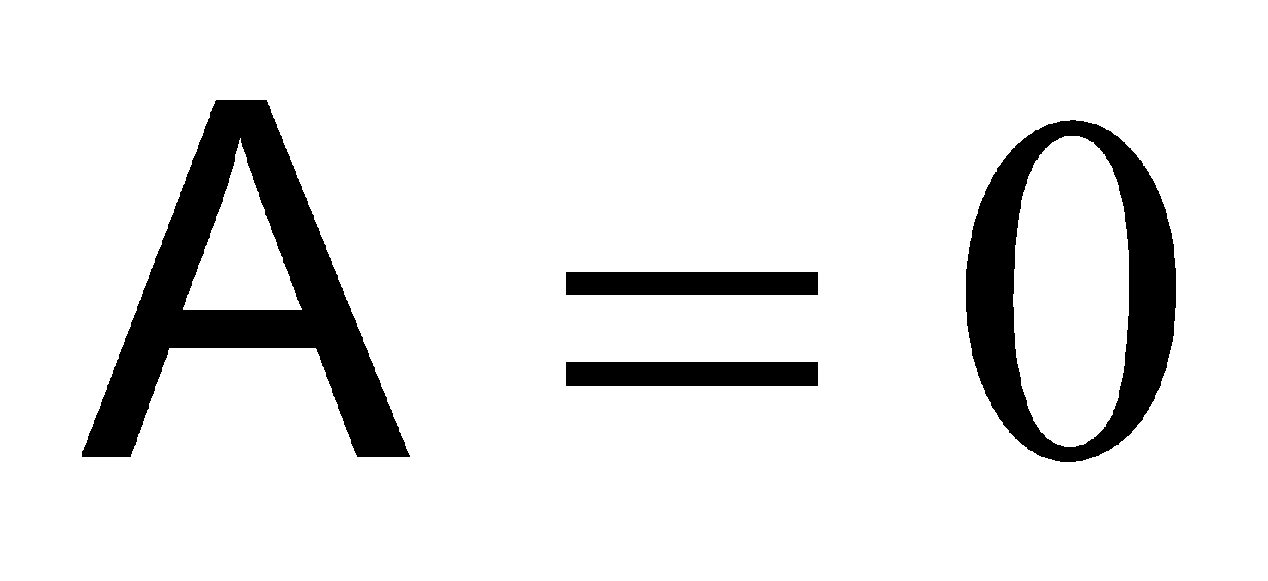
5-Varaible K-map
BC\DE | 00 | 01 | 11 | 10
00 | 0 | 1 | 3 | 2
01 | 4 | 5 | 7 | 6
11 | 12 | 13 | 15 | 14
10 | 8 | 9 | 11 | 10

Slide 21
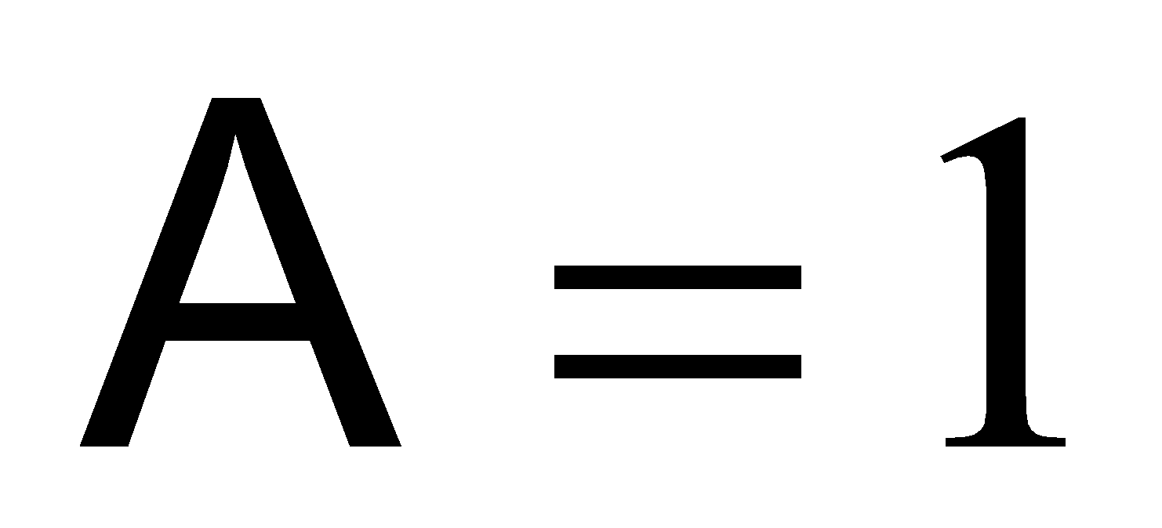
5-Varaible K-map
BC\DE | 00 | 01 | 11 | 10
00 | 16 | 17 | 19 | 18
01 | 20 | 21 | 23 | 22
11 | 28 | 29 | 31 | 30
10 | 24 | 25 | 27 | 26

Slide 22
5-Varaible K-map
BC\DE | 00 | 01 | 11 | 10
00 | 0 | 1 | 3 | 2
01 | 4 | 5 | 7 | 6
11 | 12 | 13 | 15 | 14
10 | 8 | 9 | 11 | 10
BC\DE | 00 | 01 | 11 | 10
00 | 16 | 17 | 19 | 18
01 | 20 | 21 | 23 | 22
11 | 28 | 29 | 31 | 30
10 | 24 | 25 | 27 | 26

Slide 23
Simplification of a 5-Variable K-map
5 variable K-map mapping
5 variable K-map grouping
5 variable K-map simplification

Slide 24
5-Varaible K-map simplification
BC\DE | 00 | 01 | 11 | 10
00 | 0 | 1 | 0 | 1
01 | 0 | 1 | 0 | 0
11 | 0 | 0 | 0 | 1
10 | 0 | 0 | 1 | 1

Slide 25
5-Varaible K-map simplification
BC\DE | 00 | 01 | 11 | 10
00 | 1 | 1 | 0 | 0
01 | 1 | 1 | 0 | 0
11 | 0 | 0 | 0 | 1
10 | 0 | 1 | 1 | 1
Notes:
‹#›
Consider the groups that are formed
Starting with A=0 map. The cells 1 and 5 form a group of two cells.
These two cells along with cells 17 and 21 in map A=1 from a group of 4 cells.
This group of 4 cells represents the term B*D*E
Consider the cell 2 in map A=0.
Cell 2 does not form a group with any adjacent cells. Therefore it is a group of single cell having the product term A*B*C*DE*
Consider the cells 10 and 11 in map A=0. These two cells form a group of four with adjacent cells 26 and 27 in map A=1
Therefore the group of 4 cells represents the product term BC*D
Similarly the cells 11 and 14 in map A=0 and cells 26 and 30 represent a group of 4 cells representing the product term BDE*
Now considering the map A=1.
The 4 cells 16, 17, 20 and 21 represent the product term AB*D*
The cell 25 along with cell 27 in map A=1 represent the product term ABC*E

Slide 26
5-Varaible K-map
BC\DE | 00 | 01 | 11 | 10
00 | 0 | 1 | 3 | 2
01 | 4 | 5 | 7 | 6
11 | 12 | 13 | 15 | 14
10 | 8 | 9 | 11 | 10
BC\DE | 00 | 01 | 11 | 10
00 | 16 | 17 | 19 | 18
01 | 20 | 21 | 23 | 22
11 | 28 | 29 | 31 | 30
10 | 24 | 25 | 27 | 26

Slide 27
5-Varaible K-map simplification
BC\DE | 00 | 01 | 11 | 10
00 | 0 | 1 | 0 | 1
01 | 0 | 1 | 0 | 0
11 | 0 | 0 | 0 | 1
10 | 0 | 0 | 1 | 1
BC\DE | 00 | 01 | 11 | 10
00 | 1 | 1 | 0 | 0
01 | 1 | 1 | 0 | 0
11 | 0 | 0 | 0 | 1
10 | 0 | 1 | 1 | 1

Slide 28
Functions having multiple outputs
Ckt receives a BCD number input
Displays decimal number 0 to 9 on a single digit 7-segment display
Ckt receives two 2-bit numbers A and B
Sets one of three outputs to >, =, or <

Slide 29
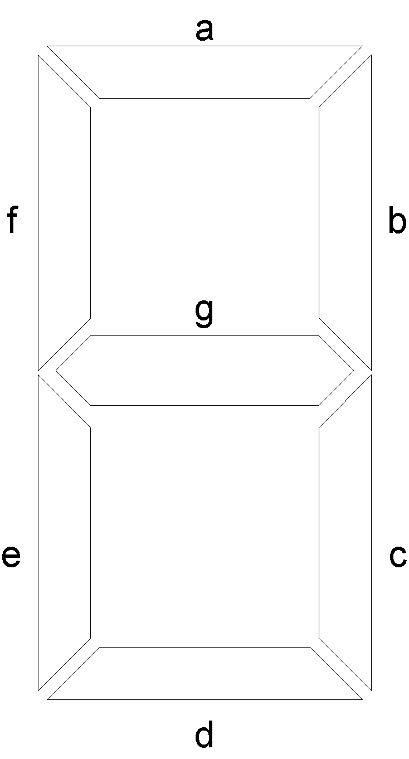
7-Segment Display
Notes:
‹#›
7-Segment display is shaped like the number 8
It has 7-segments that can be lit in different combinations to display any digit between 0 to 9.
The 7-segments are identified by segment numbers a, b, c, d, e, f and g.
The three horizontal segments starting from the top are a, g and f respectively
The two vertical segments on the right side are segments b and c
The two vertical segments on the left side are segments f and e
To display the numbers 0 to 9 different set of segments are turned on
0 a, b, c, d, e, f
1 b, c
2 a, b, d, e, g
3 a, b, c, d, g
4 b, c, f, g
5 a, c, d, f, g
6 a, c, d, e, f, g
7 a, b, c
8 a, b, c, d, e, f, g
9 a, b, c, d, f, g
The segment a, for example is turned on when numbers 0, 2, 3, 5, 6, 7 and 8 are displayed
The segment d, for example is turned on when the numbers 0, 2, 3, 5, 6 and 8 re displayed.
Similarly different sets of segments are selected to display different digits.
The 7-segment display circuit basically can be considered to be 7 different circuits having 4 inputs and 1 output
The 4-bit input of the circuit accepts BCD numbers and the output controls a single segment.
Before implementing the 7 circuits, function tables for each of the 7 circuits have to be prepared.

Slide 30
 | A | B | C | D | a | b | c | d | e | f | g
 | 0 | 0 | 0 | 0
 | 0 | 0 | 0 | 1
 | 0 | 0 | 1 | 0
 | 0 | 0 | 1 | 1
 | 0 | 1 | 0 | 0
 | 0 | 1 | 0 | 1
 | 0 | 1 | 1 | 0
 | 0 | 1 | 1 | 1
 | 1 | 0 | 0 | 0
 | 1 | 0 | 0 | 1
 | 1 | 0 | 1 | 0
 | 1 | 0 | 1 | 1
 | 1 | 1 | 0 | 0
 | 1 | 1 | 0 | 1
 | 1 | 1 | 1 | 0
 | 1 | 1 | 1 | 1

Slide 31
Function Table for Segment ‘a’
Inputs |  |  |  | Output
A | B | C | D | a
0 | 0 | 0 | 0 | 1
0 | 0 | 0 | 1 | 0
0 | 0 | 1 | 0 | 1
0 | 0 | 1 | 1 | 1
0 | 1 | 0 | 0 | 0
0 | 1 | 0 | 1 | 1
0 | 1 | 1 | 0 | 1
0 | 1 | 1 | 1 | 1
Inputs |  |  |  | Output
A | B | C | D | a
1 | 0 | 0 | 0 | 1
1 | 0 | 0 | 1 | 1
1 | 0 | 1 | 0 | X
1 | 0 | 1 | 1 | X
1 | 1 | 0 | 0 | X
1 | 1 | 0 | 1 | X
1 | 1 | 1 | 0 | X
1 | 1 | 1 | 1 | X
Notes:
‹#›

Slide 32
Function Table for Segment ‘a’
Inputs |  |  |  | Output
A | B | C | D | a
0 | 0 | 0 | 0
0 | 0 | 0 | 1
0 | 0 | 1 | 0
0 | 0 | 1 | 1
0 | 1 | 0 | 0
0 | 1 | 0 | 1
0 | 1 | 1 | 0
0 | 1 | 1 | 1
Inputs |  |  |  | Output
A | B | C | D | a
1 | 0 | 0 | 0
1 | 0 | 0 | 1
1 | 0 | 1 | 0
1 | 0 | 1 | 1
1 | 1 | 0 | 0
1 | 1 | 0 | 1
1 | 1 | 1 | 0
1 | 1 | 1 | 1
Notes:
‹#›

Slide 33
Function Table for Segment ‘b’
Inputs |  |  |  | Output
A | B | C | D | b
0 | 0 | 0 | 0 | 1
0 | 0 | 0 | 1 | 1
0 | 0 | 1 | 0 | 1
0 | 0 | 1 | 1 | 1
0 | 1 | 0 | 0 | 1
0 | 1 | 0 | 1 | 0
0 | 1 | 1 | 0 | 0
0 | 1 | 1 | 1 | 1
Inputs |  |  |  | Output
A | B | C | D | b
1 | 0 | 0 | 0 | 1
1 | 0 | 0 | 1 | 1
1 | 0 | 1 | 0 | X
1 | 0 | 1 | 1 | X
1 | 1 | 0 | 0 | X
1 | 1 | 0 | 1 | X
1 | 1 | 1 | 0 | X
1 | 1 | 1 | 1 | X
Notes:
‹#›

Slide 34
Function Table for Segment ‘c’
Inputs |  |  |  | Output
A | B | C | D | c
0 | 0 | 0 | 0 | 1
0 | 0 | 0 | 1 | 1
0 | 0 | 1 | 0 | 0
0 | 0 | 1 | 1 | 1
0 | 1 | 0 | 0 | 1
0 | 1 | 0 | 1 | 1
0 | 1 | 1 | 0 | 1
0 | 1 | 1 | 1 | 1
Inputs |  |  |  | Output
A | B | C | D | c
1 | 0 | 0 | 0 | 1
1 | 0 | 0 | 1 | 1
1 | 0 | 1 | 0 | X
1 | 0 | 1 | 1 | X
1 | 1 | 0 | 0 | X
1 | 1 | 0 | 1 | X
1 | 1 | 1 | 0 | X
1 | 1 | 1 | 1 | X
Notes:
‹#›

Slide 35
Function Table for Segment ‘d’
Inputs |  |  |  | Output
A | B | C | D | d
0 | 0 | 0 | 0 | 1
0 | 0 | 0 | 1 | 0
0 | 0 | 1 | 0 | 1
0 | 0 | 1 | 1 | 1
0 | 1 | 0 | 0 | 0
0 | 1 | 0 | 1 | 1
0 | 1 | 1 | 0 | 1
0 | 1 | 1 | 1 | 0
Inputs |  |  |  | Output
A | B | C | D | d
1 | 0 | 0 | 0 | 1
1 | 0 | 0 | 1 | 1
1 | 0 | 1 | 0 | X
1 | 0 | 1 | 1 | X
1 | 1 | 0 | 0 | X
1 | 1 | 0 | 1 | X
1 | 1 | 1 | 0 | X
1 | 1 | 1 | 1 | X
Notes:
‹#›

Slide 36
Function Table for Segment ‘e’
Inputs |  |  |  | Output
A | B | C | D | e
0 | 0 | 0 | 0 | 1
0 | 0 | 0 | 1 | 0
0 | 0 | 1 | 0 | 1
0 | 0 | 1 | 1 | 0
0 | 1 | 0 | 0 | 0
0 | 1 | 0 | 1 | 0
0 | 1 | 1 | 0 | 1
0 | 1 | 1 | 1 | 0
Inputs |  |  |  | Output
A | B | C | D | e
1 | 0 | 0 | 0 | 1
1 | 0 | 0 | 1 | 0
1 | 0 | 1 | 0 | X
1 | 0 | 1 | 1 | X
1 | 1 | 0 | 0 | X
1 | 1 | 0 | 1 | X
1 | 1 | 1 | 0 | X
1 | 1 | 1 | 1 | X
Notes:
‹#›

Slide 37
Function Table for Segment ‘f’
Inputs |  |  |  | Output
A | B | C | D | f
0 | 0 | 0 | 0 | 1
0 | 0 | 0 | 1 | 0
0 | 0 | 1 | 0 | 0
0 | 0 | 1 | 1 | 0
0 | 1 | 0 | 0 | 1
0 | 1 | 0 | 1 | 1
0 | 1 | 1 | 0 | 1
0 | 1 | 1 | 1 | 0
Inputs |  |  |  | Output
A | B | C | D | f
1 | 0 | 0 | 0 | 1
1 | 0 | 0 | 1 | 1
1 | 0 | 1 | 0 | X
1 | 0 | 1 | 1 | X
1 | 1 | 0 | 0 | X
1 | 1 | 0 | 1 | X
1 | 1 | 1 | 0 | X
1 | 1 | 1 | 1 | X
Notes:
‹#›

Slide 38
Function Table for Segment ‘g’
Inputs |  |  |  | Output
A | B | C | D | g
0 | 0 | 0 | 0 | 0
0 | 0 | 0 | 1 | 0
0 | 0 | 1 | 0 | 1
0 | 0 | 1 | 1 | 1
0 | 1 | 0 | 0 | 1
0 | 1 | 0 | 1 | 1
0 | 1 | 1 | 0 | 1
0 | 1 | 1 | 1 | 0
Inputs |  |  |  | Output
A | B | C | D | g
1 | 0 | 0 | 0 | 1
1 | 0 | 0 | 1 | 1
1 | 0 | 1 | 0 | X
1 | 0 | 1 | 1 | X
1 | 1 | 0 | 0 | X
1 | 1 | 0 | 1 | X
1 | 1 | 1 | 0 | X
1 | 1 | 1 | 1 | X
Notes:
‹#›

Slide 39
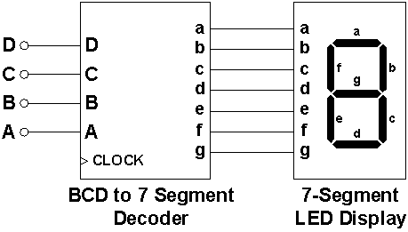
BCD to 7 Segment Decoder
Notes:
‹#›

Slide 40
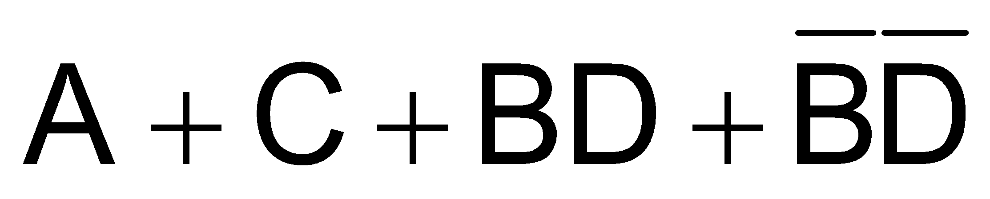
Karnaugh Map for Segment ‘a’
AB\CD | 00 | 01 | 11 | 10
00 | 1 | 0 | 1 | 1
01 | 0 | 1 | 1 | 1
11 | x | x | x | x
10 | 1 | 1 | x | x
Notes:
‹#›

Slide 41
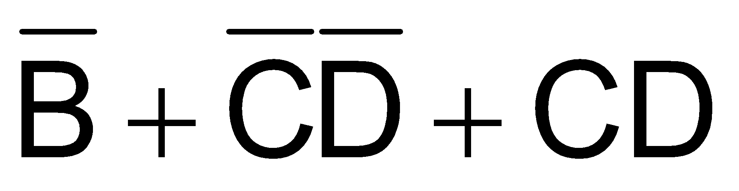
Karnaugh Map for Segment ‘b’
AB\CD | 00 | 01 | 11 | 10
00 | 1 | 1 | 1 | 1
01 | 1 | 0 | 1 | 0
11 | x | x | x | x
10 | 1 | 1 | x | x
Notes:
‹#›

Slide 42
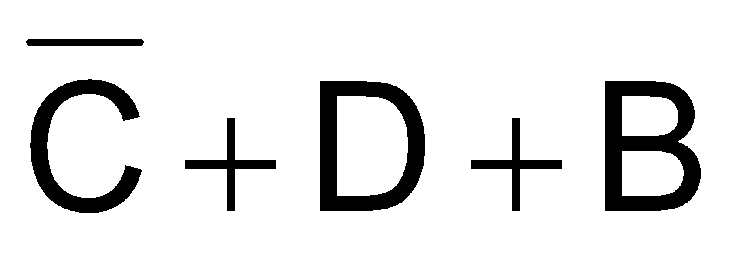
Karnaugh Map for Segment ‘c’
AB\CD | 00 | 01 | 11 | 10
00 | 1 | 1 | 1 | 0
01 | 1 | 1 | 1 | 1
11 | x | x | x | x
10 | 1 | 1 | x | x
Notes:
‹#›

Slide 43
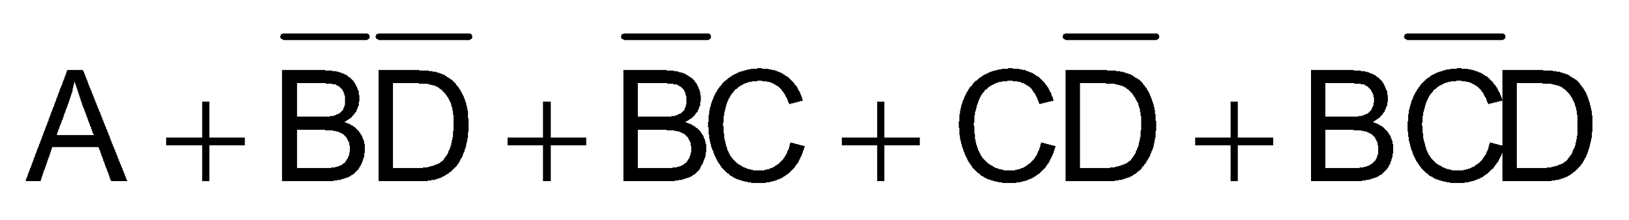
Karnaugh Map for Segment ‘d’
AB\CD | 00 | 01 | 11 | 10
00 | 1 | 0 | 1 | 1
01 | 0 | 1 | 0 | 1
11 | x | x | x | x
10 | 1 | 1 | x | x
Notes:
‹#›

Slide 44

Karnaugh Map for Segment ‘e’
AB\CD | 00 | 01 | 11 | 10
00 | 1 | 0 | 0 | 1
01 | 0 | 0 | 0 | 1
11 | x | x | x | x
10 | 1 | 0 | x | x
Notes:
‹#›

Slide 45
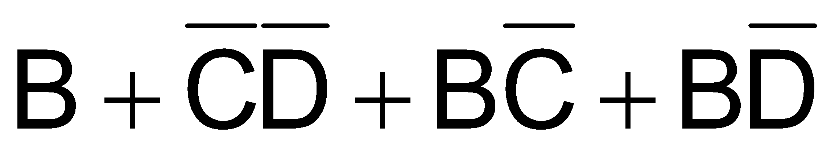
Karnaugh Map for Segment ‘f’
AB\CD | 00 | 01 | 11 | 10
00 | 1 | 0 | 0 | 0
01 | 1 | 1 | 0 | 1
11 | x | x | x | x
10 | 1 | 1 | x | x
Notes:
‹#›

Slide 46

Karnaugh Map for Segment ‘g’
AB\CD | 00 | 01 | 11 | 10
00 | 0 | 0 | 1 | 1
01 | 1 | 1 | 0 | 1
11 | x | x | x | x
10 | 1 | 1 | x | x
Notes:
‹#›

Slide 47
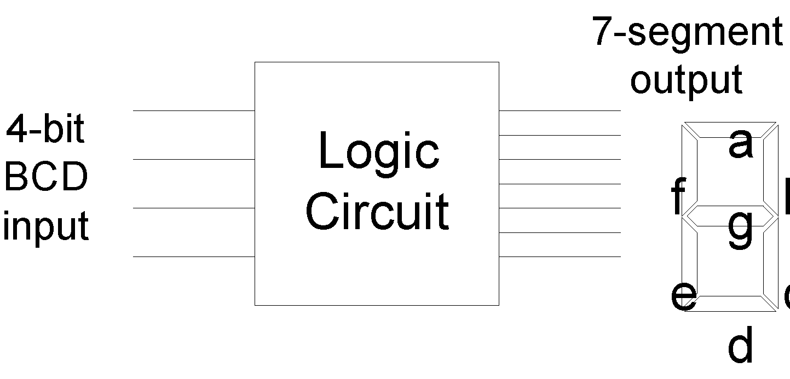
7-Segment Circuit

Slide 48
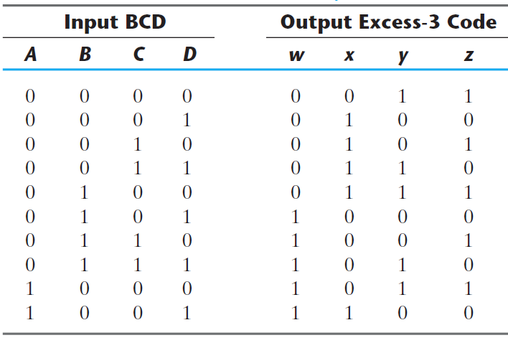
CODE CONVERSION

Slide 49
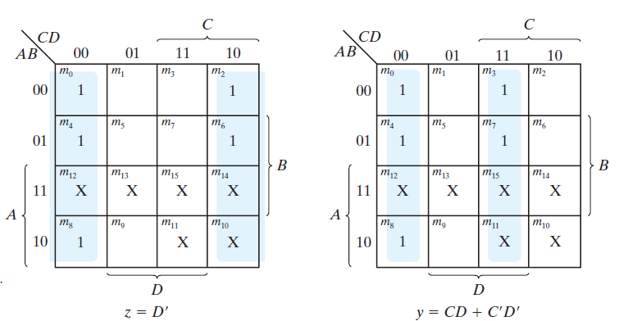
CODE CONVERSION

Slide 50
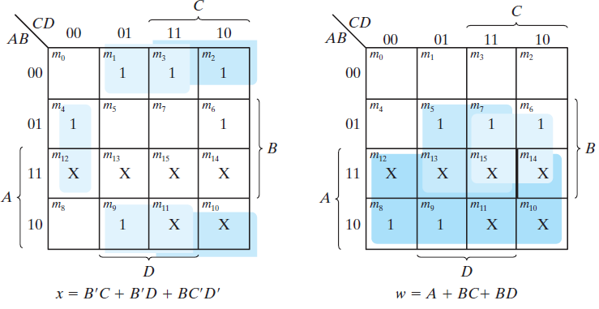
CODE CONVERSION

Slide 51
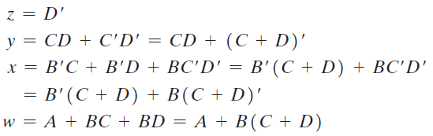
CODE CONVERSION

Slide 52
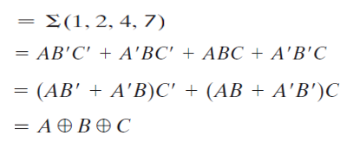
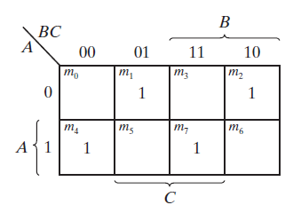
ODD FUNCTION
A | B | C | F
0 | 0 | 0 | 0
0 | 0 | 1 | 1
0 | 1 | 0 | 1
0 | 1 | 1 | 0
1 | 0 | 0 | 1
1 | 0 | 1 | 0
1 | 1 | 0 | 0
1 | 1 | 1 | 1

Slide 53
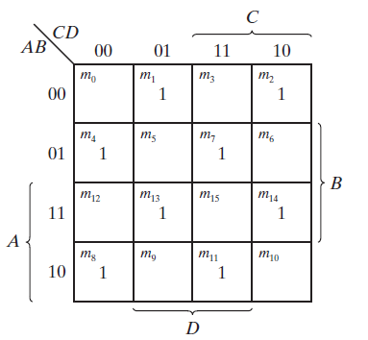

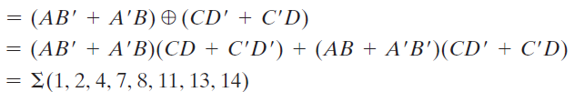
ODD FUNCTION

Slide 54
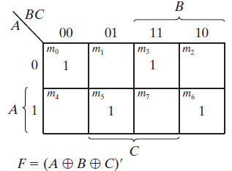
EVEN FUNCTION
A | B | C | F
0 | 0 | 0 | 1
0 | 0 | 1 | 0
0 | 1 | 0 | 0
0 | 1 | 1 | 1
1 | 0 | 0 | 0
1 | 0 | 1 | 1
1 | 1 | 0 | 1
1 | 1 | 1 | 0

Slide 55
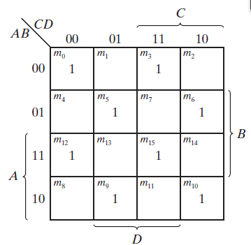

EVEN FUNCTION

Slide 56
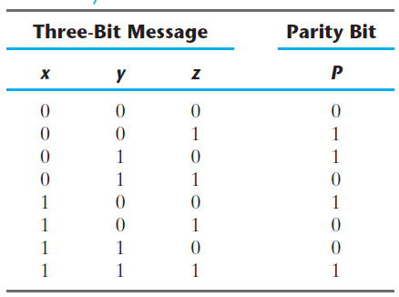
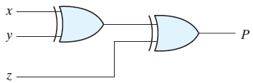

EVEN PARITY GENERATOR

Slide 57
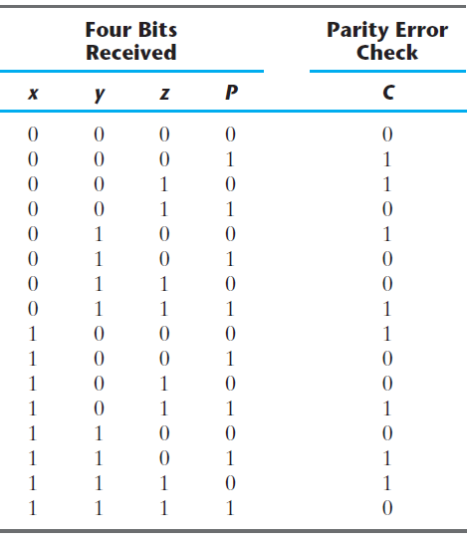
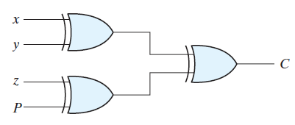

EVEN PARITY GENERATOR

Slide 58
Implicants & Prime Implicants
Implicant: A group of one or more k map cell
Prime implicant: an implicant that is not a subset of another implicant
Essential Prime Implicant: a prime implicant that covers at least one cell not covered by another prime implicant

Slide 59
Implicants & Prime Implicants
F(A, B, C, D) = (0, 2, 3, 5, 7, 8, 9, 10, 11, 13, 15)

Slide 60
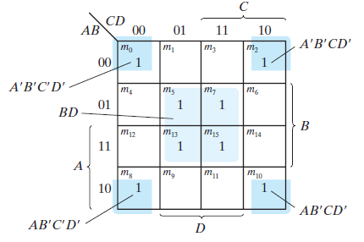
Implicants & Prime Implicants
F(A, B, C, D) = (0, 2, 3, 5, 7, 8, 9, 10, 11, 13, 15)

Slide 61
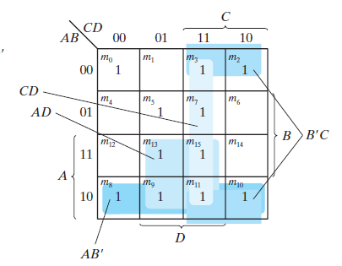
Implicants & Prime Implicants
F(A, B, C, D) = (0, 2, 3, 5, 7, 8, 9, 10, 11, 13, 15)

Slide 62

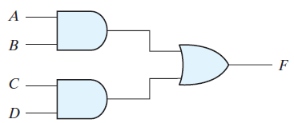
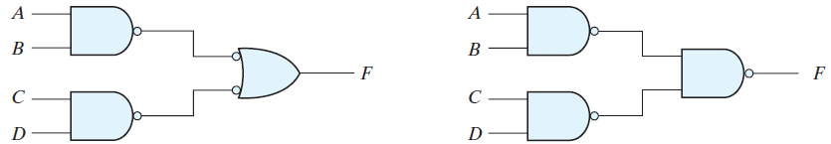
MULTILEVEL NAND CIRCUITS

Slide 63

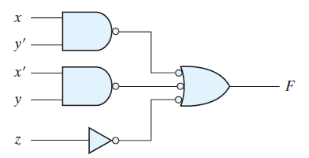
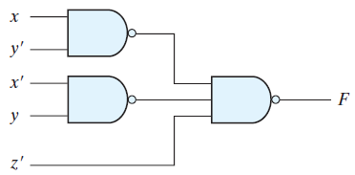
MULTILEVEL NAND CIRCUITS

Slide 64

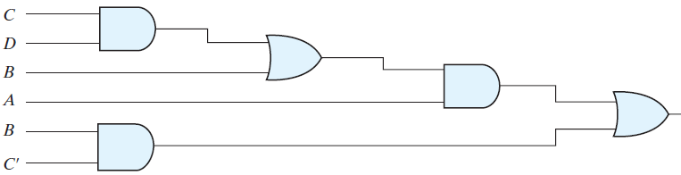
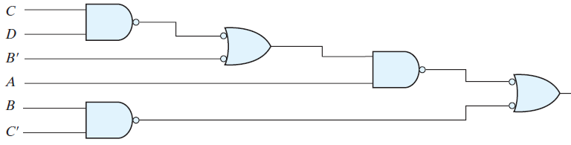
MULTILEVEL NAND CIRCUITS

Slide 65
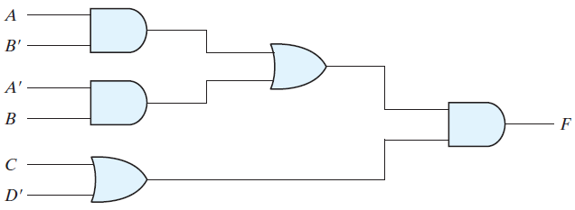
MULTILEVEL NAND CIRCUITS

Slide 66

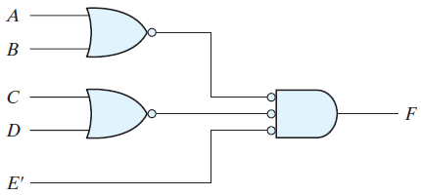
MULTILEVEL NOR CIRCUITS

Slide 67

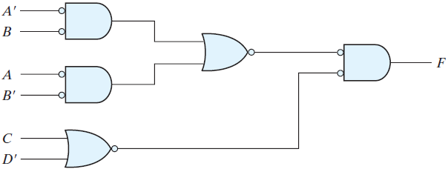
MULTILEVEL NOR CIRCUITS

